Slide 1
TOUCH DIMMER SWITCH CIRCUIT
Md. Aftab (171FA05037)
R.V.L Karthik (171FA05329)
M.V. Narasimha Rao (171FA05179)

Slide 2
ABSTRACT:
In this project we are controlling the intensity of light by using a touch sensor which is responsible for dimmer action. So we can control the light brightness easily with respect to surrounding ambiance.

Slide 3
INTRODUCTION:
A Dimmer Switch will allow us to control the brightness of the light.
Without a Dimmer Switch, the light bulbs tend to glow at full brightness consuming maximum power.
If full brightness is not required, then Dimmer Switches can be used and save some energy.
With the help of a Dimmer Switch, we can vary the brightness from fully off to fully on.

Slide 4
COMPONENTS REQUIRED:
Arduino UNO
Touch Sensor(TTP223)
2N2222 NPN Transistor
Small Bulb
1 KΩ Resistor
Power supply
Breadboard
Jumper Wires

Slide 5
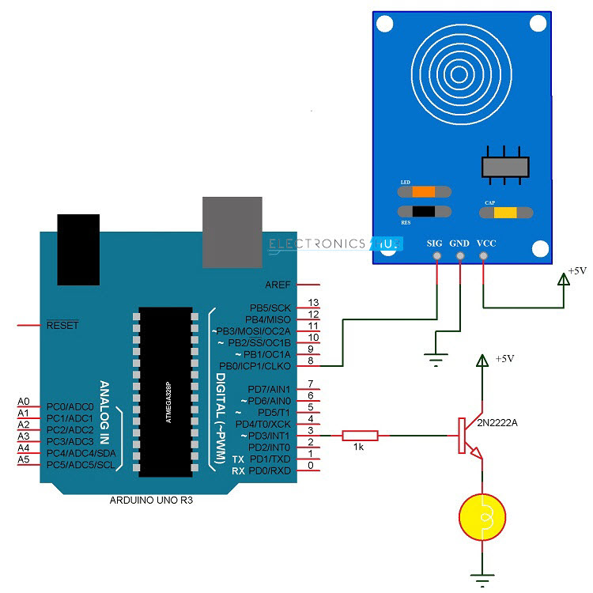
CIRCUIT DIAGRAM:

Slide 6
WORKINNG:
When the finger is placed on the touch sensor, Arduino UNO detects the change in the logic state of the sensor’s output and drive the bulb using Pulse Width Modulation (PWM). Hence, the bulb is connected to a PWM pin of the Arduino UNO.
As we continue to place the finger on the touch sensor, Arduino UNO slowly increases the intensity of the bulb with the help of PWM
This process continues until the finger is lifted or maximum brightness is reached i.e. the bulb is fully ON. In order to decrease the brightness of the bulb, double tap and on the double tap, continue to place the finger on the touch sensor.

Slide 7
Arduino UNO is programmed such that, if a double tap is detected (two touches with a very view raw small delay) it has to reduce the brightness of the bulb and thus acting as a dimmer switch.
Similar logic of PWM is used for reducing the brightness of the bulb where, when continued to place the finger on the double tap (tap once and tap and hold the finger on second tap), the intensity of the bulb gradually decreases until the finger is lifted or the bulb reaches minimum brightness i.e. it is completely OFF. This is how a Touch Dimmer Switch circuit using Arduino

Slide 8
APPLICATIONS:
The Touch Dimmer Switch can be used to control the brightness of a bulb by simply touching the sensor.
Can replace traditional Dimmer Switches like slide switch or rotary type switch for bulbs.

